Slide 1
My Experience using Git and Github
The “Project Mgt with Git and GitHub” presentation and relevant videos helped me in understanding the basics and use of Git and GitHub.
In the upcoming Capstone Projects, there will be many versions of the same documents that will be modified by me and my team members. Therefore, keeping a record of the changes made and availability of all the documents in a single place, i.e., GitHub will reduce our worries to keep track of every document. This will be my first-time experience using Git and GitHub and I look forward to gaining more knowledge regarding the same as we progress in our Capstone Project.

Slide 2
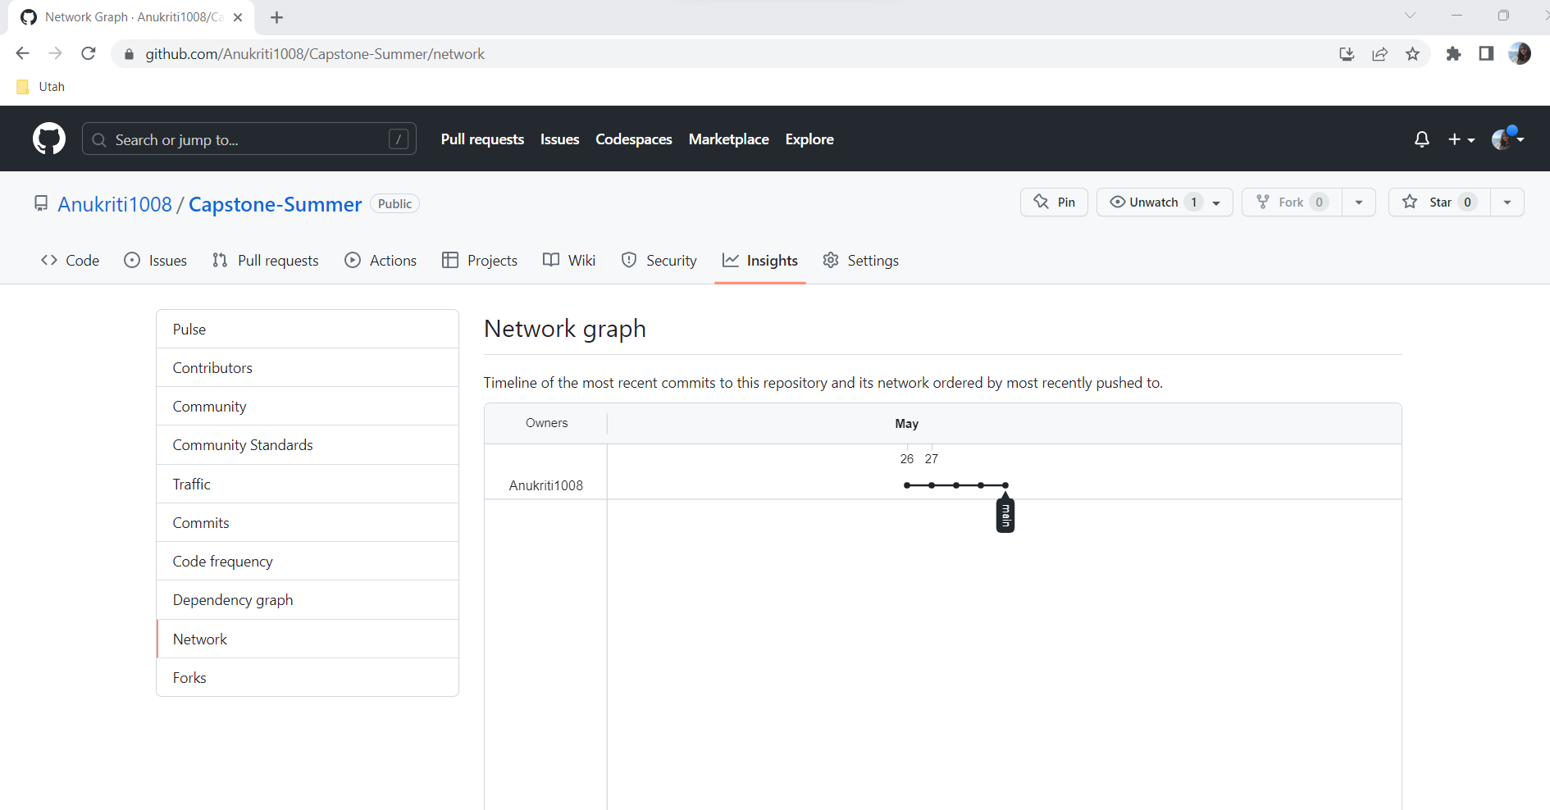
My Repository Network Diagram

